Slide 1



SNS COLLEGE OF ENGINEERING Kurumbapalayam (Po), Coimbatore – 641 107 AN AUTONOMOUS INSTITUTION Accredited by NAAC – UGC with ‘A’ Grade Approved by AICTE, New Delhi & Affiliated to Anna University, Chennai
DEPARTMENT OF COMPUTER SCIENCE AND ENGINEERING
19DT102-DESIGN THINKING & INNOVATION
II-YEAR / III-SEMESTER
LAW TRANSLATOR AND SUMMARIZER
TEAM MEMBERS:
Dilipkumar. S
Elavarasan. C
Dharwin. V
Darshan.D
GUIDED BY:
Ms. DEEPA P
Assistant Professor/CSE

Slide 2
INNOVATION TECHNOLOGIES
7 - INNOVATION TECHNOLOGIES:
ROBOTICS & AUTOMATION
AR/VR/META-VERSE/GAMING & DIGITAL TWINS
DATA SCIENCE /AI/ ML
INTERNET OF THINGS
COMMUNICATION AND GROWTH TECH
ADDITIVE MANUFACTURING (3D Printing)
LOW CODE DEVELOPMENT

Slide 3
INDUSTRY VERTICALS
7-INNOVATION INDUSTRY VERTICALS :
SMART CITY/MANUFACTURING
HEALTH CARE
AGRICULTURE & FOOD TECHNOLOGY
AUTOMOBILES
AEROSPACE AND DEFENCE
RETAIL, REAL ESTATE, ENTERTAINMENT & FINANCE
POWER/ENERGY

Slide 4
EMPATHY
Certainly! Developing an empathy-driven Law translator and summarizer project involves understanding the nuanced language of legal documents and the potential impact on individuals. Consider incorporating user-friendly interfaces, clear explanations, and contextual summaries to make legal information accessible and less intimidating for users.
Regular user feedback and iterative improvements can enhance the tool's effectiveness and user experience. Creating an empathy-focused law translator and summarizer for uneducated individuals could enhance access to legal information..
Empathy: All the models and ideas that have been made under the topic prevention of railway accident is still in development and will many difficulties in developing it. So most of the models are failing in financial part. Using expensive materials, Simple drones, sensors in tracks etc. But they are not insisting in preventing the accidents with cost productive materials.

Slide 5
DEFINE
The aim is to facilitate cross-language understanding of legal content and offer condensed versions for easier comprehension.
The project typically integrates natural language processing and machine learning techniques to ensure accurate translation and summarization of complex legal language.

Slide 6
IDEATE
1.Multilingual Legal Translation
2.Context-Aware Summarization
3.Case Law Analysis
4.LAW TRANSLATOR AND SUMMARIZER

Slide 7
PROTOTYPE
SYSTEM ARCHITECTURE:
The system consists of the following modules:
1. Document phrasing
2. Language transactier
3. Summarizer
4. Law enforcement

Slide 8


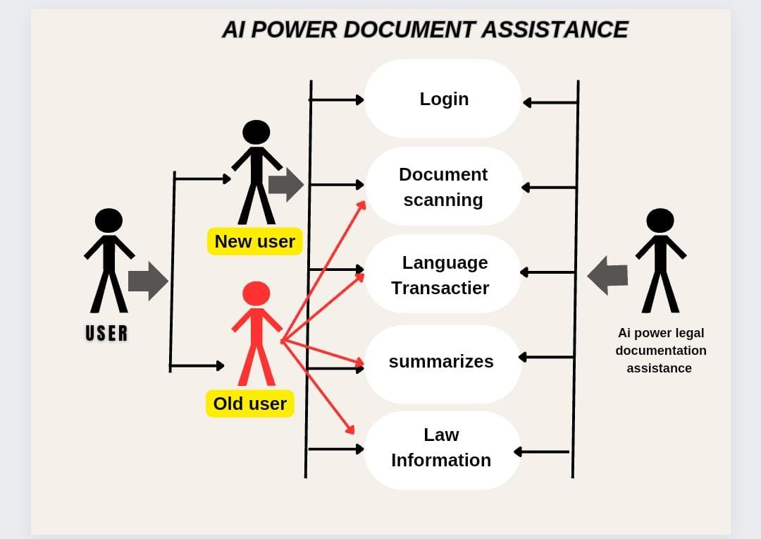

Slide 9
PROTOTYPE
A Law Translator and Summarizer project typically involves developing a system that can translate legal documents between different languages and provide concise summaries of the content. The translator aspect focuses on converting legal texts from one language to another, considering the specialized terminology and nuances of legal language. This is crucial for legal professionals working with documents in foreign languages.
PROPOSED WORK:
The proposed law translation system is typically involves developing a system that can translate legal documents between different languages and provide concise summaries of the content. The translator aspect focuses on converting legal texts from one language to another, considering the specialized terminology and nuances of legal language. This is crucial for legal professionals working with documents in foreign languages. The summarizer part aims to condense lengthy legal documents into shorter, more digestible summaries while retaining the essential information.

Slide 10
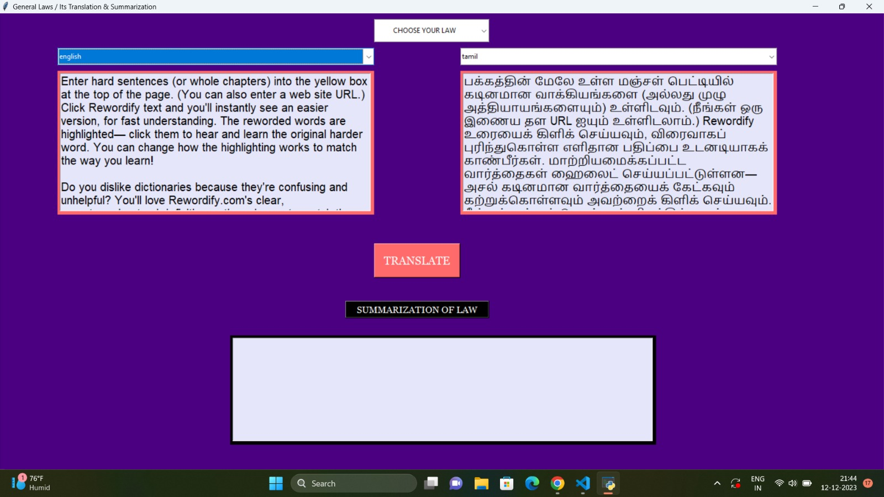
Prototype

Slide 11
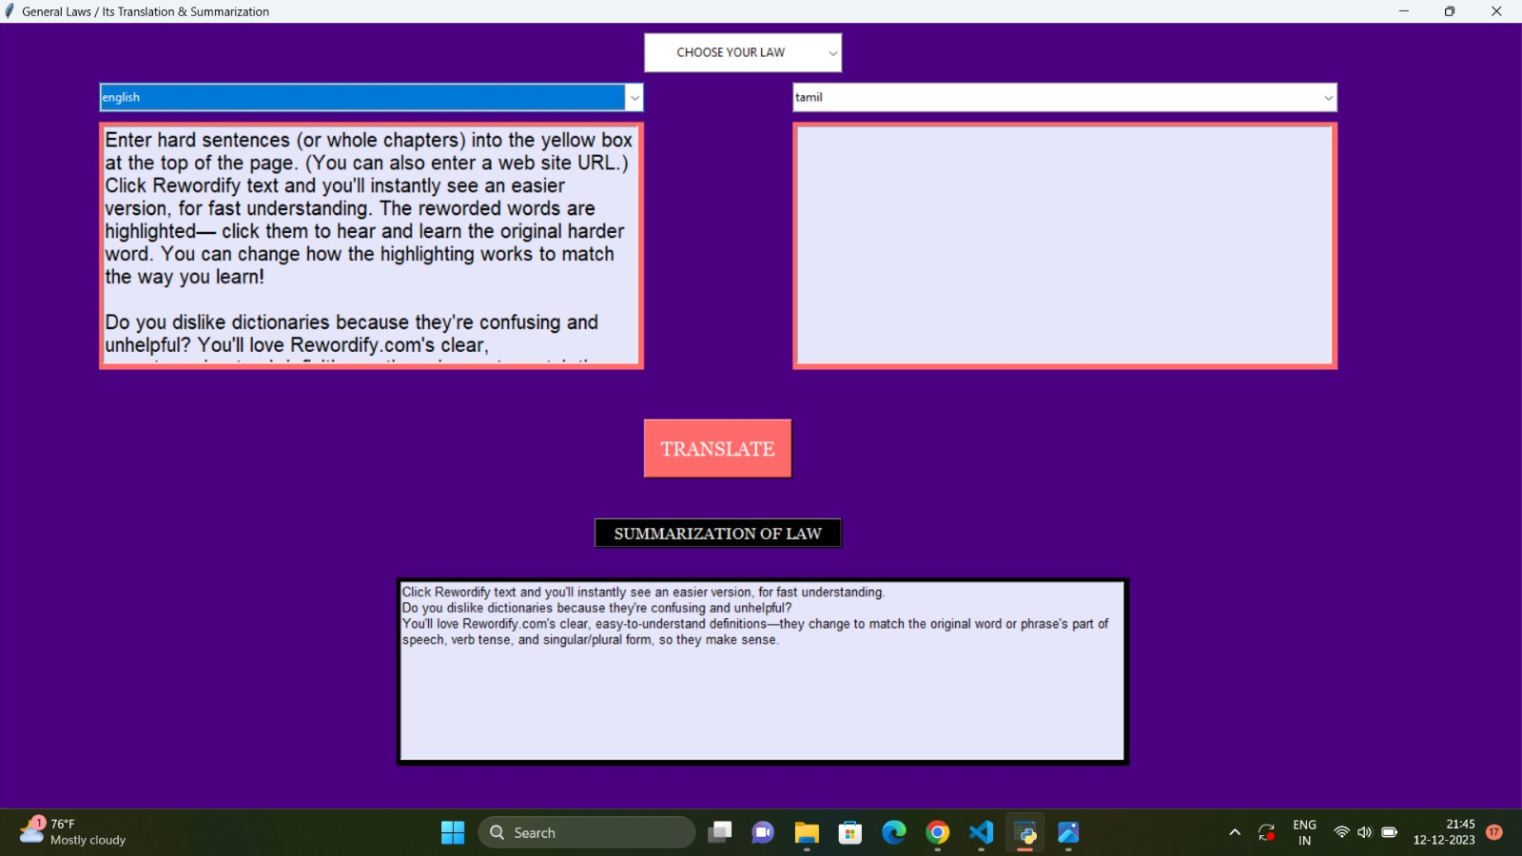

Slide 12
PROTOTYPE
MAIN FEATURES:
• Phrases the given document
• Use text as an intermediate
• Translates the given document in required language
• Website based interface
• Fully responsive: Everything is responsive ready so need to worry about how this site will look on mobile, tablet, and desktop.
• Summarise the given document
• Provide the required information
• Best use for the consumers in the law sector
• Easy to use
• User-friendly

Slide 13
PROTOTYPE
Platforms used :
Google colab.
Visual studio
Chat gpt
Programming language used:
Python3

Slide 14
REFERENCE
] RanuDewangan, Pratibhadevi Umesh “Automatic Accident Control
Sysem on Railway Tracks” International Journal of Advanced
Research in Electronics and Communication Engineering(IJARECE)
Volume 5, Issue 7, July 2016.
[2] Ms.K.Divya&Ms.R.Anjugam “Railway Safety Monitoring System
using Ultrasonic and IR Sensor” IJSRD- International Journal for
Scientific Research & Development vol. 5, Issue 01, 2017/
ISSN(Online):2321-0613.
[3] SarathChandran.P, Karthika.M “IOT Based Accident Prevention and
Monitoring System In Railways” International Journal of Advanced
Research Trends in Engineering and Technology(IJARTET) VOL. 5,
Special Issue 5, March 2018
[4] RinkeshKumar Yadav, Rohini Temkar “Combined Iot and Cloud
Computing Solution for Railway Accident Avoidance “International
Research Journal of Engineering and Technology(IRJET) VOL: 4,
Issue: 06|Jun.2019.

Slide 15
THANK YOU

